Slide 1




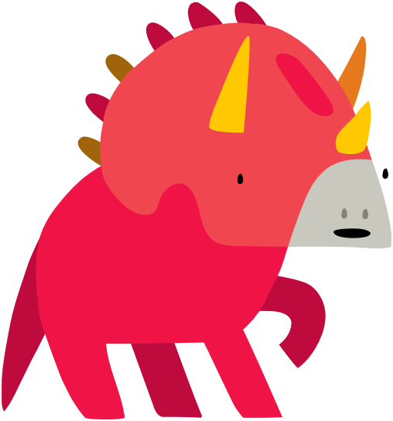
Lesson 7:
Knock, knock!
Knock,
knock!
Who’s
there?

Slide 2
Slide

Slide 3
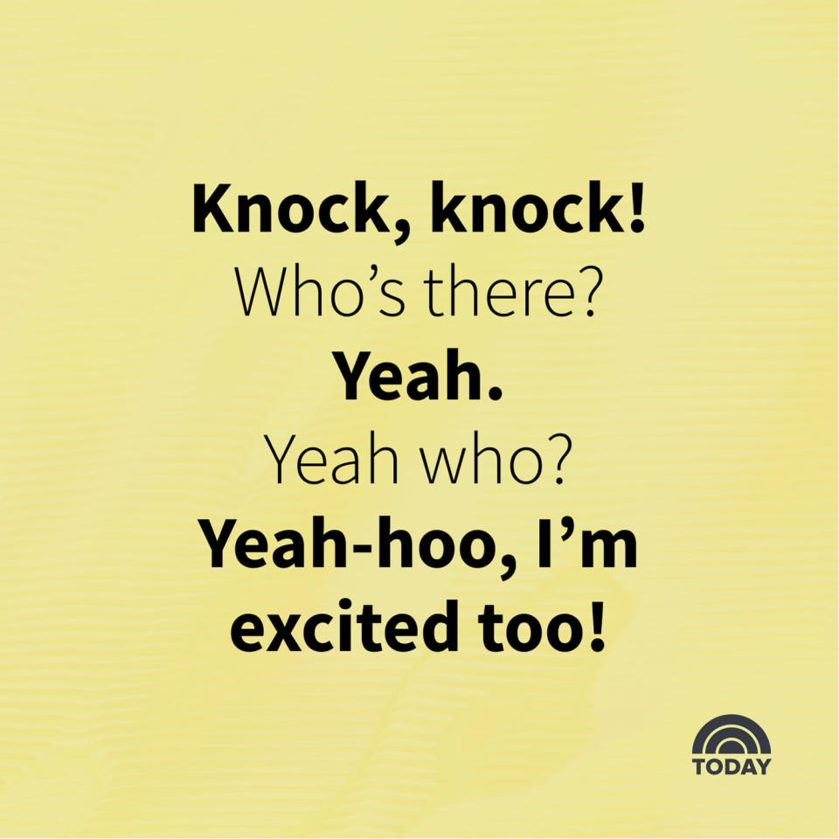
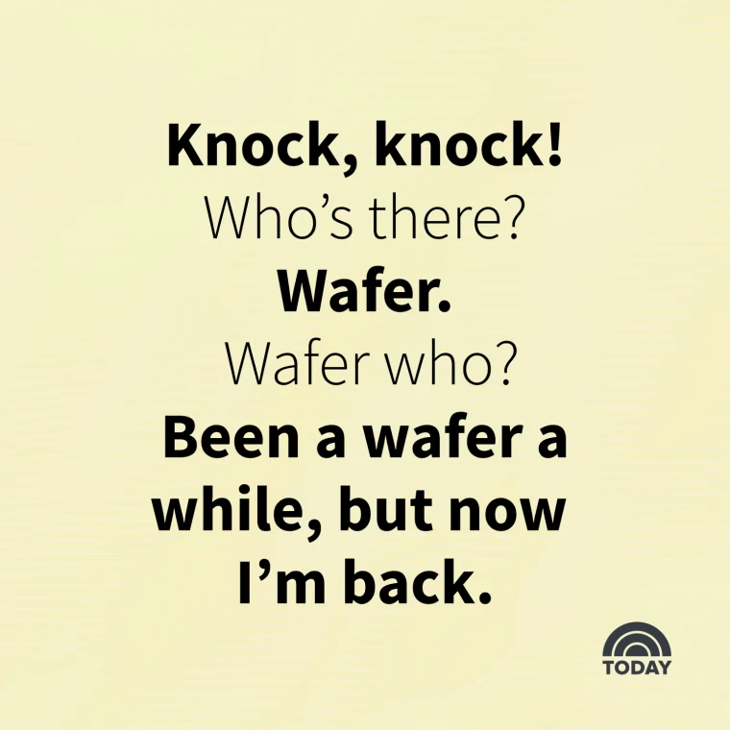
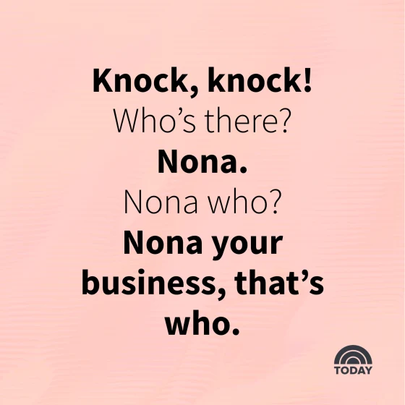
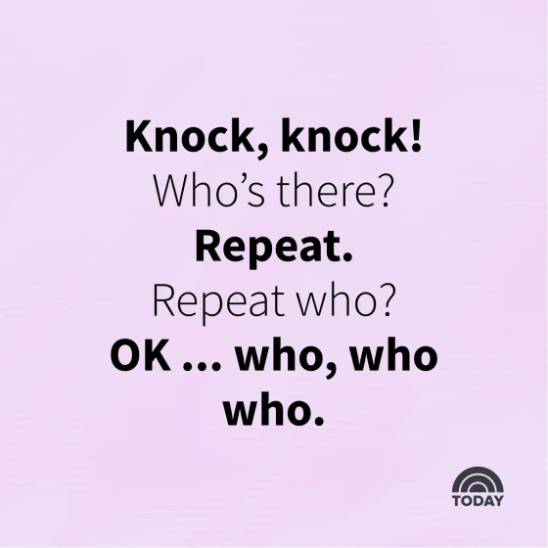
Knock-knock Jokes

Slide 4
Knock-knock Jokes
Place to find more knock-knock jokes:
www.today.com/life/inspiration/knock-knock-jokes-rcna44380

Slide 5


Our Joke
Knock,
knock!
Who’s
there?

Slide 6


Our Joke
Yeah Who?
Yeah!

Slide 7

Our Joke
Yeah-hoo! I’m excited too!

Slide 8


Backdrop

Slide 9
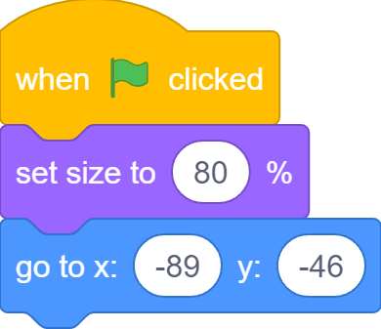
Sprites
First Dinosaur

Slide 10
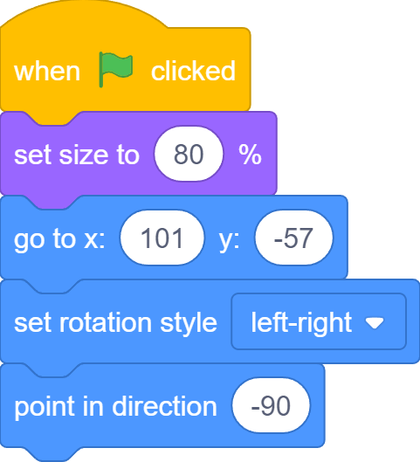
Sprites
Second Dinosaur

Slide 11
The Stage is Set!

Slide 12
Slide

Slide 13
Slide

Slide 14
Slide

Slide 15
Slide

Slide 16
Slide

Slide 17
Slide

Slide 18
Slide

Slide 19
Slide

Slide 20
Slide

Slide 21
Slide

Slide 22
Slide

Slide 23

What we learnt…
How to control game character with keyboard keys

Slide 24
Exercises
Can you make the crab to start at a random x position?
Can you add sound effect when turtle reaches ocean?
Can you add sound effect when crab catches turtle?
Can you add more crabs?
Can you make crabs bounce around on the stage instead?
Can you stop all the crab when turtle reaches the ocean?

Slide 25
Thank you and see you in the next lesson!

